Slide 1
Project meeting (2016-12-19) - DVA313
Created by: Group 2 – Solar energy calculator

Slide 2
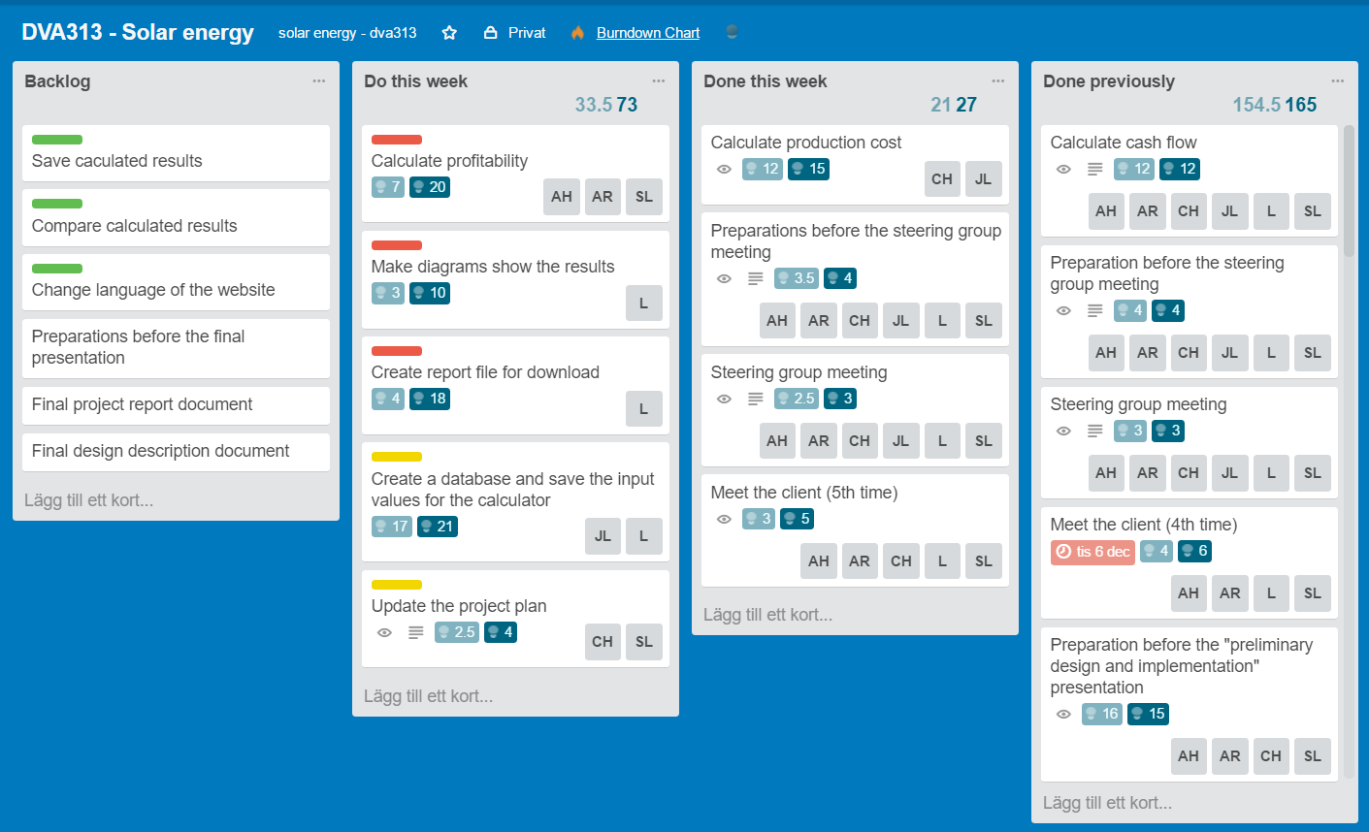
Trello board – Week 50 (previous)

Slide 3
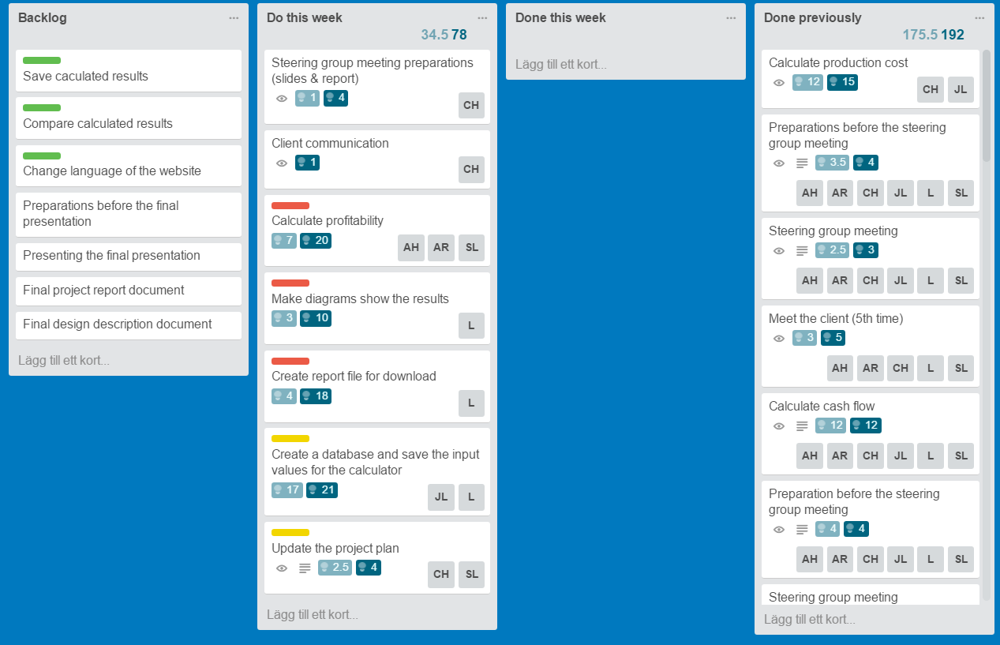
Trello board – Week 51 (present)

Slide 4
Any obstacles, risks or issues that have been identified
Holidays are coming up = possible disturbances in the work flow, communication and integrating each others’ code
Quite a lot of implementation/documentation that have to be done – solution: divide the work and start coding/writing

Slide 5
Worked hours for each member
Name | Week 1 (hours) | Week 2 (hours) | Week 3 (hours) | Week 4 (hours) | Week 5 (hours) | Week 6 (hours) | Total
Lukas Hamacek | 6 | 18 | 10 | 15 | 18 | 10 | 77
Aliya Hussain | 7 | 16 | 9 | 10 | 15 | 10 | 67
Charlie Höglund | 8 | 19.5 | 14 | 18 | 18,5 | 14 | 92
Jonathan Larsson | 6 | 13 | 19.5 | 11 | 16 | 14 | 79,5
Sebastian Lindgren | 12.5 | 16.5 | 13 | 12 | 20 | 9 | 83
Avalika Reddy | 6 | 13 | 9 | 10 | 15 | 9 | 62

Slide 6
Questions for the steering group
If we have any further questions we will email you

